Slide 1

Job Applications
Dr. Jukkalkar Syed Imtiaz
Department of English
Shri Shivaji Science & Arts College, Chikhli

Slide 2

A job application letter (also known as a cover letter) is a letter you send with your resume to provide information on your skills and experience.
This letter is your chance to “sell” yourself to an employer, explaining why you are an ideal candidate for a position.

Slide 3
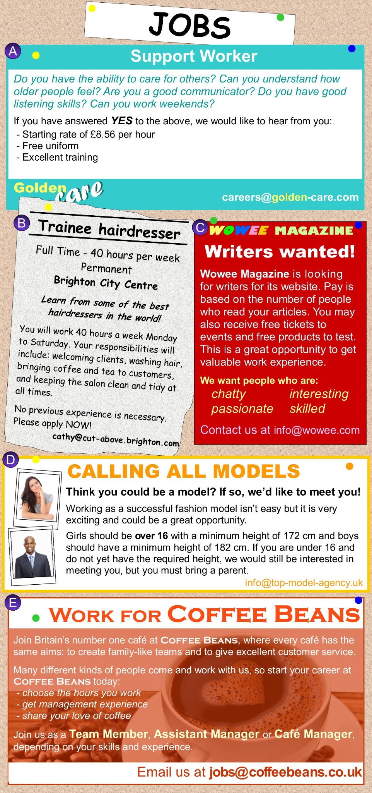

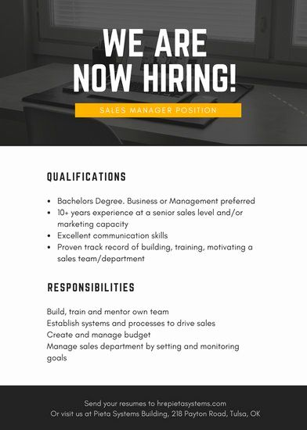

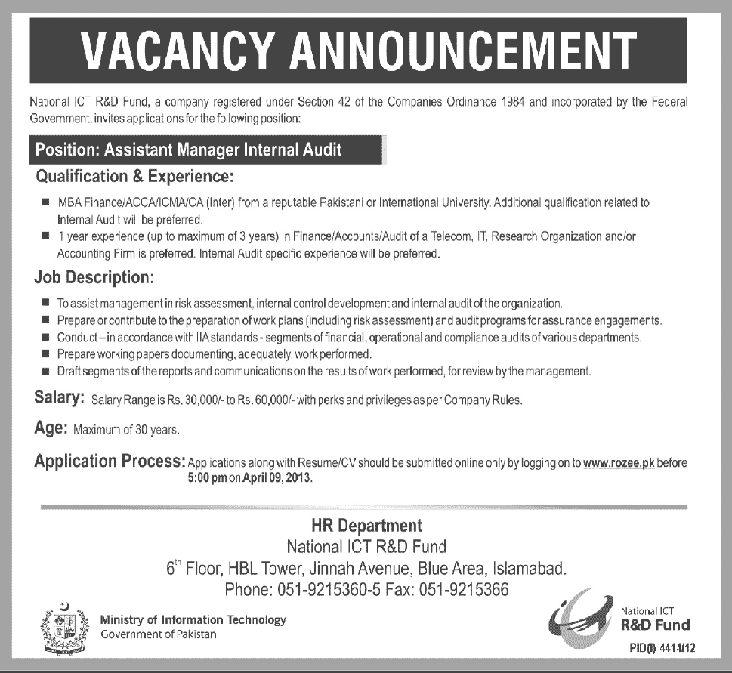
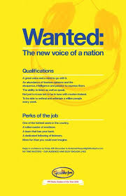


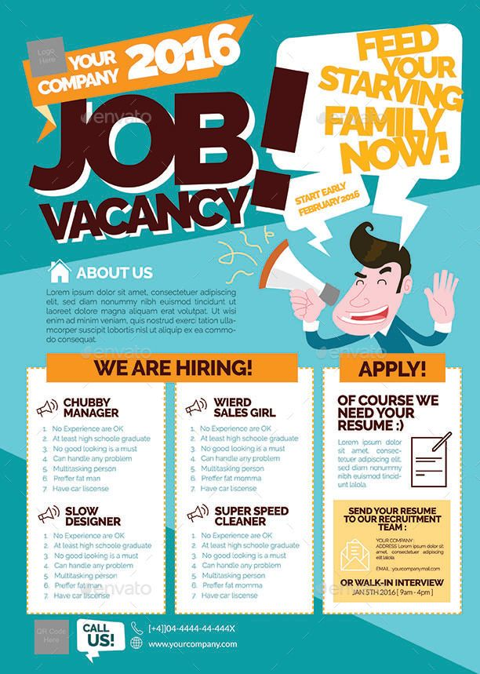

Slide 4
How to Decipher a Job Advertisement
skim through : go or move quickly and lightly over.
company's write-up : a report or article that makes a judgment about a company
persuasive cover letters Persuade the mind of the employer.
The structure for job advertisements tends to be fairly consistent.
Still, that doesn't mean you should skim through a job posting.
Carefully reviewing the company's write-up of a job will allow you to write persuasive cover letters.
save time by only applying to relevant jobs, and feel prepared for phone screens and in-person job interviews.

Slide 5
Job title
Qualifications/ Requirements/Experience : editorial assistant" and "assistant editor education, and soft and hard skills.
Responsibilities lead the team in generating XYZ create weekly report
About us : background of the company
Benefits and pay: salary commensurate with experience or competitive salary,
Experience level :Whether in terms of years or career level, sometimes postings will include details about the experience level.
As you review any section of a job description, keep in mind that the most important items are probably listed toward the top. If you fit the first four experience requirements but miss one or two at bottom, you can apply.
Remember, with many job postings it will be impossible for any single person to match perfectly.

Slide 6
Understand the phrases in the ad
self-starters
independently develop
Some of the more common phrases—self-starter, great communication skills, flexible—are intended as clues. Does a job require a "good sense of humor"?
That might signal that daily frustrations abound, and if you can't roll with the punches, you'll find yourself frustrated in the position. Jobs that require "multitasking" and "deadline-driven" applicants may have a bit too much work for one person to juggle.
Learn to read between the lines.

Slide 7
It's a good idea to review the want ad at the following points:
Initially: Your first look at the job description can be a quick review.
Before writing a cover letter: Your cover letter should be personalized to the specific job, and to the needs highlighted in the posting.
Before submitting an application: When you think you're ready to submit your application, including your cover letter, resume, and any other details requested, review the posting one more time. Have you followed the instructions correctly? Did you emphasize the correct details in your cover letter?
Before an interview: Whether it's a phone or an in-person interview, read the job description carefully be . It will remind you of the details you're likely to discuss, and show you which points to emphasize.

Slide 8
Tips for Writing a Job Application Letter
Tailor each application letter to the job.
Carefully proofread
Follow business letter format.
Decide whether to send a hard copy or email.
Language should simple without any grammatical mistake.

Slide 9
If the Job Application is Printed then follow the tips
Read the entire application before you complete it.
Pay close attention to what is being asked and how you are expected to respond.
Do not write in sections that say “Do Not Write Below This Line” or “Office Use Only.”
Create a personal data sheet. This should include all the information you might need to complete an application like names of previous employers, employment dates, addresses, telephone numbers, etc. Use it as you fill out the application.
Most applications will ask for references. Add this to your personal data sheet.
Do not use abbreviations, except for NA (not applicable).
Respond to all questions. If a question does not apply to you, use NA to indicate that it is not applicable. This shows the employer that you did not overlook anything.

Slide 10
8. Make a rough draft. Write out responses on a separate sheet of paper before completing the real application. Or get two copies and use the first one as a rough draft.
9. Write clearly. Use a black, erasable pen, and print clearly.
Proofread it. Make sure that you have no grammar or spelling errors. If possible, have someone else review the application to catch errors you might miss.
10. Keep it neat. Use correction fluid ("white out") to fix minor errors, but use it sparingly.
11. Always list your "position desired".
If you're answering a job ad or looking for a specific position, enter that job title.
If you are not applying for a specific position, enter the name of the department in which you wish to work.
Fill out more than one application if you are interested in more than one job.

Slide 11
Give a range for your salary requirements. Employers may use this question to screen out applicants. It is best to give a salary range or "negotiable", even if you know the wage. This leaves you room to negotiate a higher salary.
Give positive reasons for leaving past jobs. Choose your words carefully with this question. Avoid using the words fired, quit, illness, or personal reasons. Always use positive statements. Here are some possible ways to handle this question.
If you were fired:
Do not use the terms fired or terminated. Consider using involuntary separation.
You may want to call past employers to find out what they will say in response to reference checks. When doing so, reintroduce yourself and explain that you're looking for a new job. Be honest that your termination hurts your chances of getting another job. Past employers will usually agree to use the term "resigned." This response saves them potential headaches and even lawsuits.

Slide 12
If you quit your job, use the term "resigned" or "voluntarily separated." These responses indicate that you followed proper procedures in leaving the job. If the application asks for a reason (or if you are asked in the job interview), you can respond as follows:
Quit for a better job. This response includes leaving for advancement potential, to work closer to home, for a better work environment, or for a career change. If you quit for a better job, there should not be a long break in employment. Your employment history should support the statement.
Quit to move to another area.
Quit to attend college. If you use this reason, the education listed on your application and/or resume must reflect it.
Quit for other reasons, such as took an extended vacation/sabbatical, did volunteer work, started own business, or raised family.

Slide 13
If you were laid off from a job due to no fault of your own, indicate the reason for the layoff. Here are some possible phrases to use:
Lack of work
Lack of operating funds
Temporary employment
Seasonal employment
Company closed
Plant closing
Company in loss

Slide 14
Watch for illegal questions. Applications may contain questions that are illegal to ask before a conditional offer of employment. These include questions about:
Race
Religion
Creed

Slide 15
Present a positive, honest picture of yourself during your job search. The information that you provide is likely to become part of your permanent employment record. False information can be the basis for dismissal. Answer all questions honestly. Provide only the information that the employer wants, or that is needed to sell your qualifications. Avoid any negative information.
Target your qualifications. Include only those that meet the specific needs of the job. Many applications have limited space to record your skills, experience, and accomplishments. To decide what information to include, research the company, its products or services, and the skills needed for the job. Attach a resume that details your skills, experience, and accomplishments.

Slide 16
Job Application Letter Format
Use this formatting information as a guideline when writing your customized application letters, so you know what information goes where.
Contact Information
Name
Address
City, State
Pin Code
Phone Number
Email Address
Date
Employer Contact Information
Name
Title
Company
Address
City, State
Pin Code
Salutation
Dear Mr./Ms. Last Name, (leave out if you don't have a contact)

Slide 17
Body of Application Letter
Middle Paragraph(s)
The next section of your application letter should describe what you have to offer the employer.
It can be a single paragraph, or you can break it up into a couple of paragraphs. If the section gets lengthy, you may use bullet points to break up the text. Remember, you are interpreting your resume, not repeating it.
Mention specifically how your qualifications match the job you are applying for. In this portion of the letter, make your case for your candidacy.
It can be helpful to spend some time researching the company—this knowledge and insight helps you make an informed and persuasive argument for your candidacy.
Use specific examples whenever possible. For example, if you say that you have lots of experience working successfully on team projects, provide an example of a time you worked in a group and achieved success.
Body of Application Letter
The body of your application letter lets the employer know what position you are applying for, why the employer should select you for an interview, and how you will follow up.
First Paragraph
The first paragraph of your letter should include information on why you are writing. Mention the job you are applying for and where you found the job listing. Include the name of a mutual contact, if you have one. You might conclude by briefly and concisely saying why you think you are an ideal candidate for the job.

Slide 18
Final Paragraph
Conclude your application letter by thanking and expecting that you will be considered for the position. Include information on how you will follow up.
Complimentary Close
Sincerely,
Signature (for a hard copy letter)

Slide 19
John Donaldson
8 Sue Circle sender’s address
Smithtown, CA 08067
909-555-5555
john.donaldson@emailexample.com
August 15, 2020
George Gilhooley
Times Union
87 Delaware Road address of the person or
Hatfield, CA 08065 Company you are writing t
Subject : Application for the post of ________.
Reference: Your advertisement appeared in ___
dated_________.
Dear Mr./Ms./Mrs. {Recipient's Name} ( Salutation)
Body of the letter.
Thanking you.
Complimentary Close
Sincerely,
Signature
(Name)
Attachments:

Slide 20
Job application letter sample - 1
Subject: Application for the Role of {Sales Manager} at XYZ Ltd.
Dear Mr./Ms./Mrs. {Recipient's Name},
This is with reference to your job requirement on {portal name} for the role of Sales Manager. I truly believe that my qualifications and experience make me a perfect candidate for the job.
I completed my MBA in Sales and Marketing from {Institute Name}. I have worked as an Area Sales Manager and Assistant Marketing Manager at {Company Name}. During my stint as Area Sales Manager, I conceptualised and executed a Customer Engagement Program that resulted in higher sales. As Assistant Marketing Manager, I worked on the planning and execution of a new product launch. With 4 years of experience in sales and marketing, I have an in-depth understanding of the process. I am confident that I will be the right fit for the job.

Slide 21
I have attached my CV to the email for your reference. Please have a look at it.
I hope to meet you and discuss this opportunity further. Thank you for considering my application for the role.
Best regards,
{Your Name}
Mob: {Your Contact Number}
Email Id: {Your Email Address)

Slide 22
Job application letter sample - 2
Subject: Job Application for {Assistant Manager}
Dear Mr./ Ms./ Mrs. {Recipient's Name},
I am writing to apply for the position of Assistant Manager – Supply at your esteemed firm. I got to know about the job role through a member of your team, {Mr./Mrs. Name, Designation}, who happens to be my neighbour.
I have completed my Masters in Supply Chain Management from {University Name}. I worked as a Management Trainee for a year at {Company Name}. At {Company Name}, I gained vast knowledge and experience about supply chain management in an e-commerce field. I was also a part of the team that was responsible for planning and executing new inbound supply chain processes.
Working at your esteemed e-commerce organisation is the dream of every person who wants to make a career in supply chain management. With my experience and skills, I will surely be able to add value to your business.

Slide 23
I request you to consider my application for the post. My resume and cover letter are attached to the email. Please refer to them for more information.
Kindly feel free to contact me for further discussions.
Thank you.
Yours sincerely,
{Your Name}
Mob: {Your Contact Number}
Email Id: {Your Email Address)

Slide 24
Job application letter sample - 4
Subject: Job Application for the post of {English Teacher}
Dear Sir/Madam {Recipient's Name},
This is regarding your advertisement published in {Portal Name} regarding a vacancy for an English Teacher. I would be glad to apply for the role.
Teaching has always been my passion, and I have always been great with students. I have been a Supervisor at {School Name} for 5 years. I have also taught class VI and VII for 2 years earlier. My qualification and experience match your requirements.

Slide 25
I have attached my resume for your consideration, and request you to consider my application for the role. If you find it suitable, please feel free to contact me at the below mentioned contact details.
Thank you.
Yours sincerely,
{Your Name}
Mobile: {Your Contact Number}

Slide 26


